Slide 1
ANN
Artificial Neural Networks

Slide 2
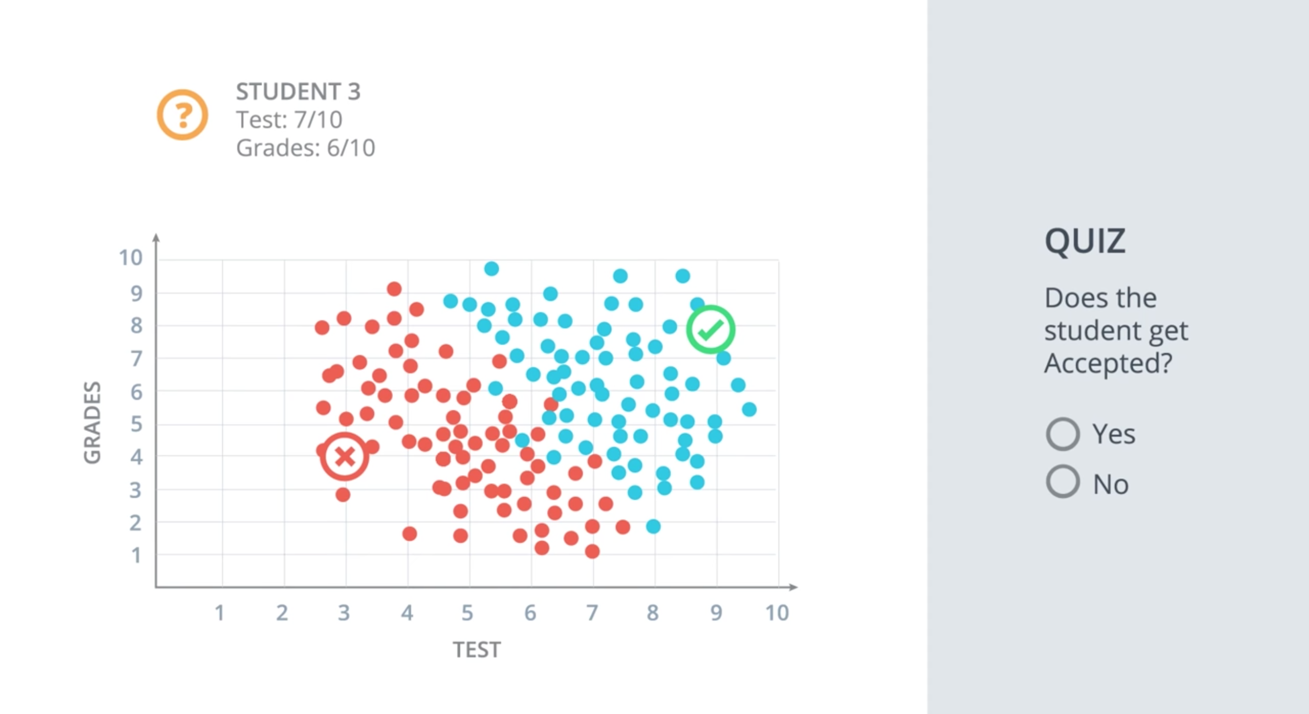

Slide 3
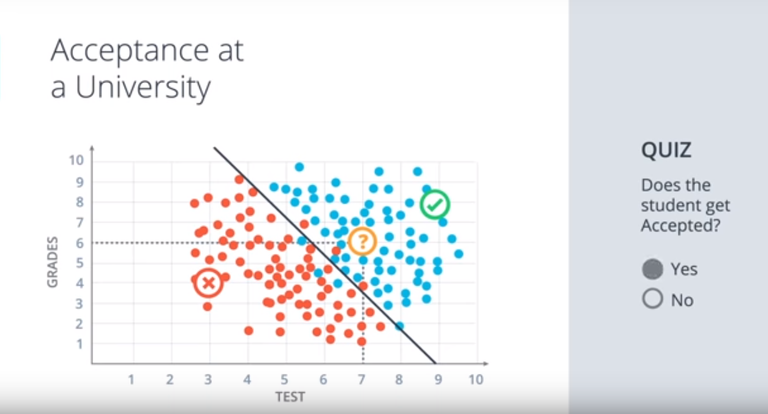

Slide 4
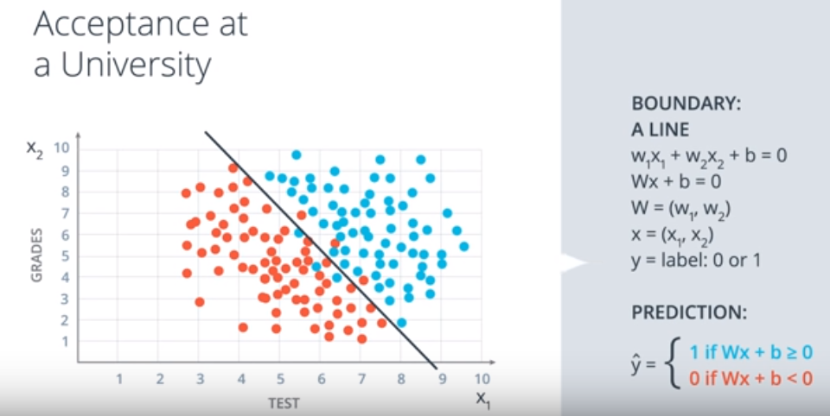

Slide 5
Applications of Deep Learning?

Slide 6
Beating professional players at games like chess, checkers and go
Detecting spam emails
Predicting stock prices
Classifying images
Diagnosing illnesses
Self-driving cars

Slide 7
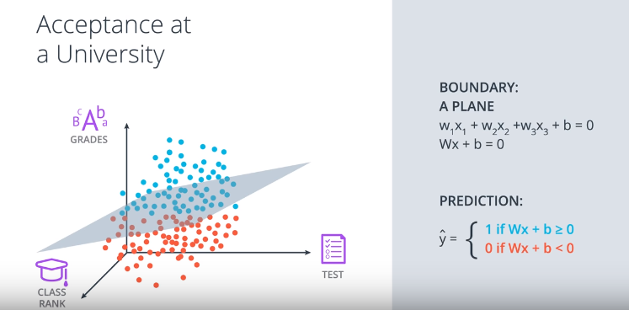
What if we have more than 2 features?

Slide 8
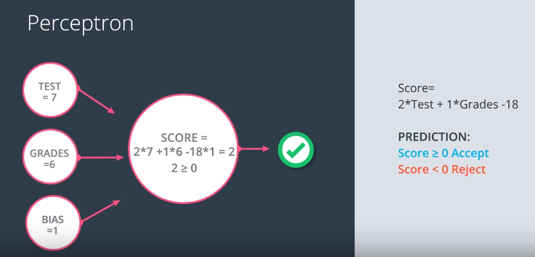
Let’s suppose that the line demarcating the 2 classes is 2*test+1*grades-18
The weights for the edges are 2,1,-18 respectively.

Slide 9
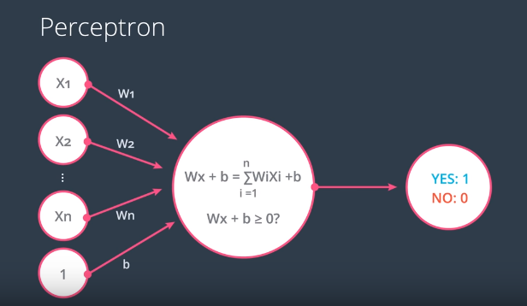
In general, this is how a perceptron model looks like!

Slide 10
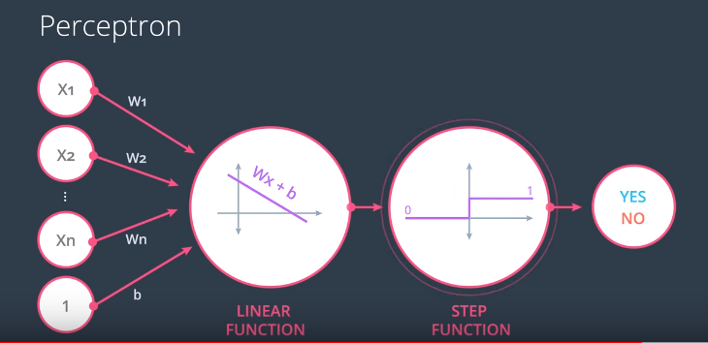
We can separate the step of checking Wx+b>0

Slide 11
QUIZ QUESTION
Given Score = 2*Test + 1*Grade - 18, suppose w1 is 1.5 instead of 2. Would the student who got 7 on the test and 6 on the grades be accepted or rejected?

Slide 12
ANSWER : REJECTED!

Slide 13
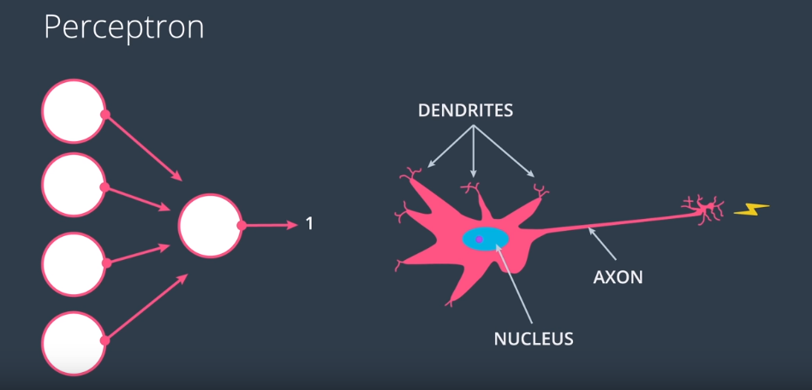

Slide 14
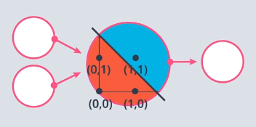
Perceptron as logical operators
FOR AND OPERATION
X1 | X2 | Y
0 | 0 | 0
0 | 1 | 0
1 | 0 | 0
1 | 1 | 1
What should be the weights for the perceptron?

Slide 15
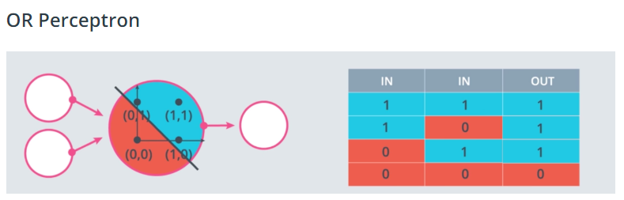
ANSWER : weight1 = 1.0, weight2 = 1.0, bias = -1.5
FOR OR PERCEPTRON
weight1 = 1.0, weight2 = 1.0, bias = -0.5

Slide 16
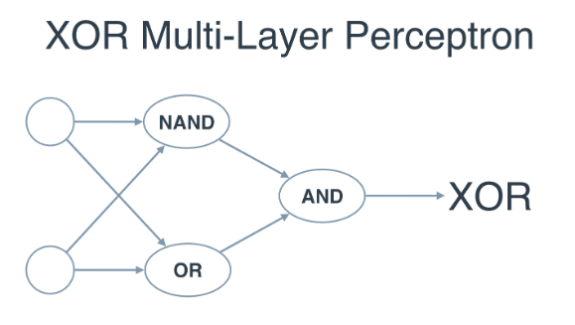
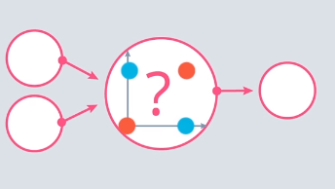
XOR perceptron
Y = (AB)’(A+B)

Slide 17
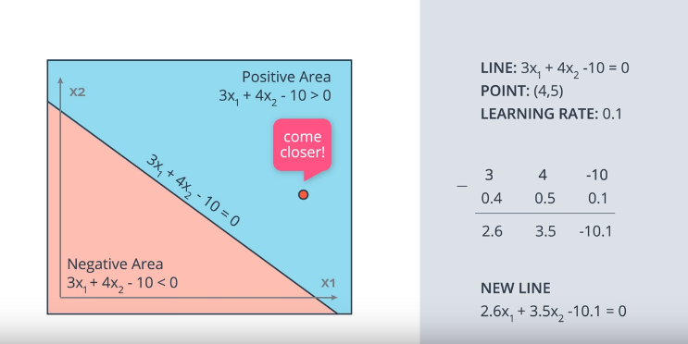

Slide 18
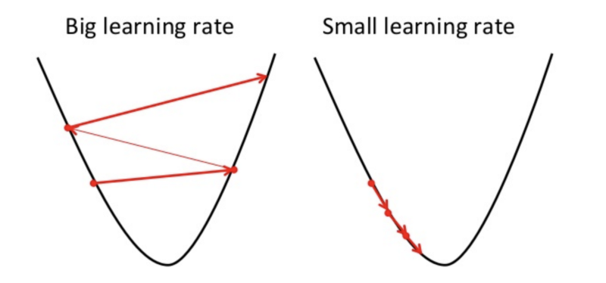
Learning rate
It determines how fast or slow we will move towards the optimal weights.
If it is too big, it maybe will not reach the local minimum because it just bounces back and forth.
If it is very small, gradient descent will eventually reach the local minimum in a long time.
Keep learning rate :neither too low nor too high.

Slide 19
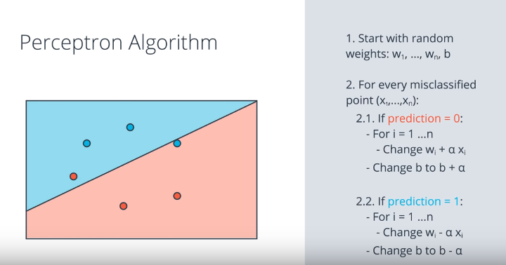

Slide 20
Error Function
The deviation of the actual output from the predicted output
Tells the model how badly it is performing

Slide 21
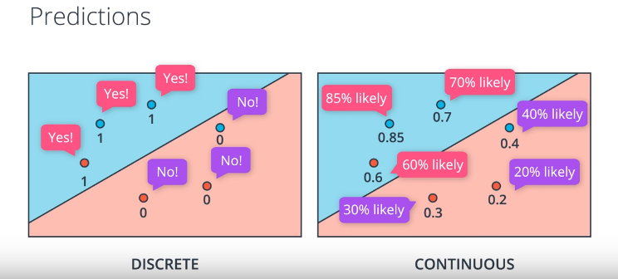

Slide 22
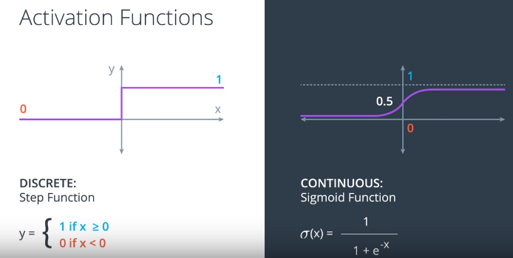

Slide 23
The sigmoid function is defined as sigmoid(x) = 1/(1+e-x). If the score is defined by 4x1 + 5x2 - 9 = score, then which of the following points has exactly a 50% probability of being blue or red?
(1,1)
(2,4)
(5,-5)

Slide 24
ANSWER: (1,1)

Slide 25
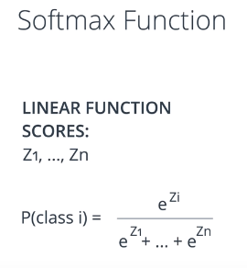
Multi class classification

Slide 26
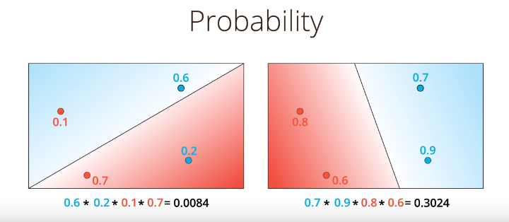

Slide 27
What function turns products into sums?
Sin
Cos
Log
exp

Slide 28
ANSWER : LOG!

Slide 29
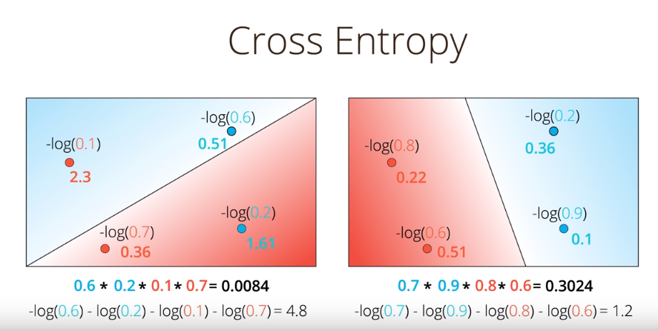
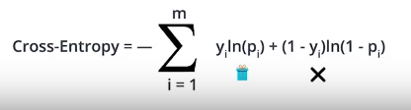

Slide 30
Logistic Regression
It is one of the most popular and useful algorithms in Machine Learning, and the building block of all that constitutes Deep Learning. It basically goes like this:
Take your data
Pick a random model
Calculate the error
Minimize the error, and obtain a better model

Slide 31
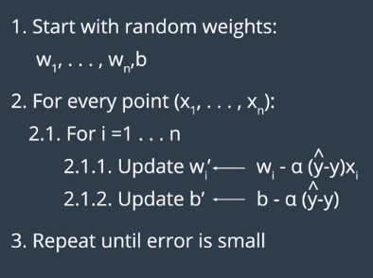
Gradient Descent

Slide 32
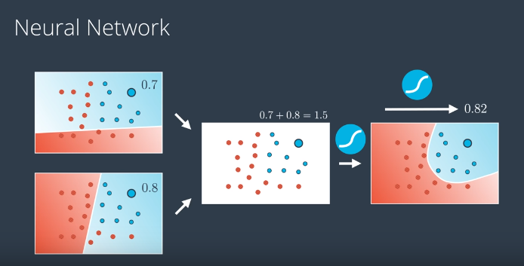
What if the data is not linearly separable?

Slide 33
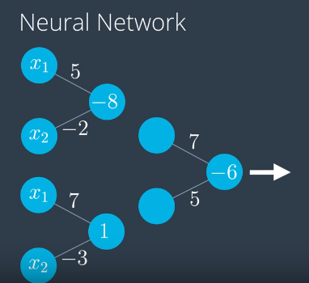
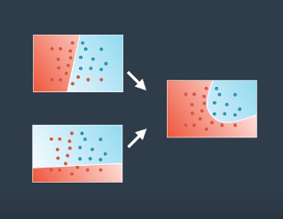
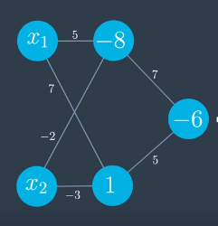

Slide 34
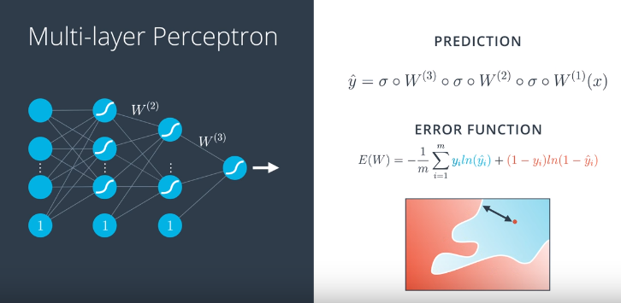
Feedforward Phase

Slide 35
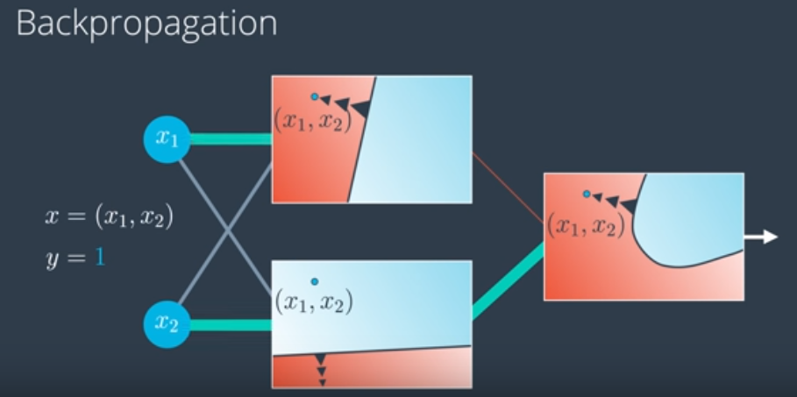
Backpropagation

Slide 36
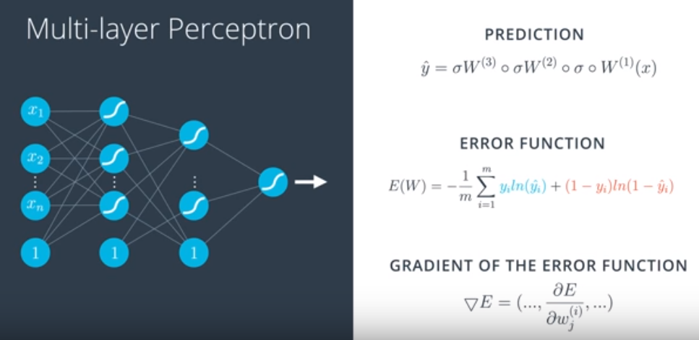
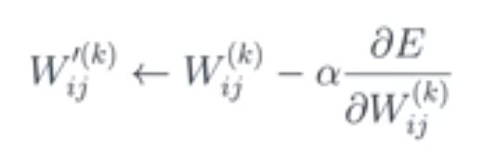

Slide 37
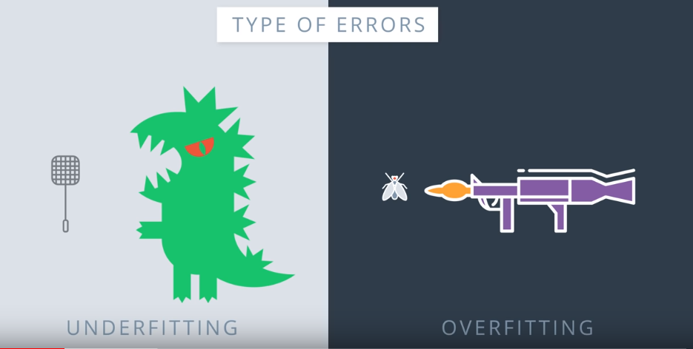
Overfitting vs Underfitting

Slide 38
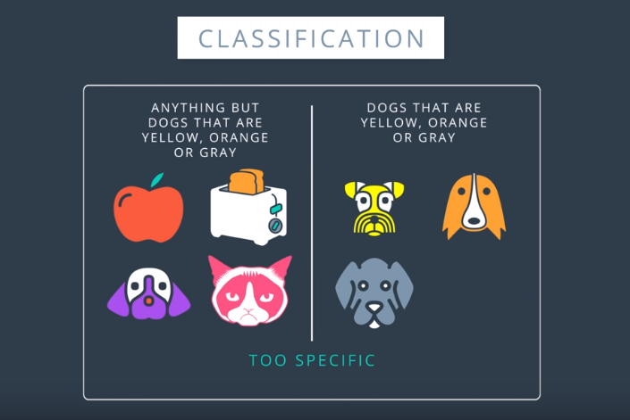
Overfitting

Slide 39
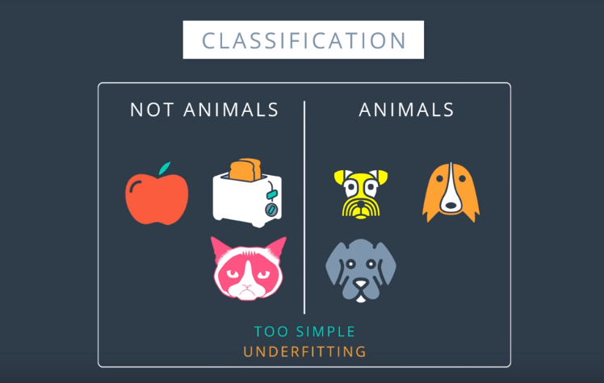
Underfitting

Slide 40
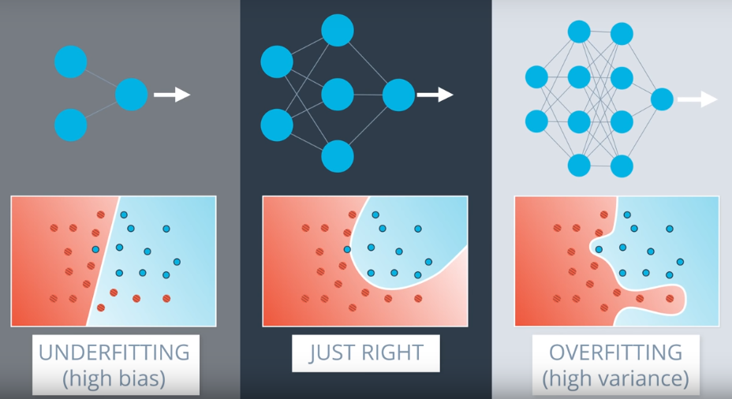

Slide 41
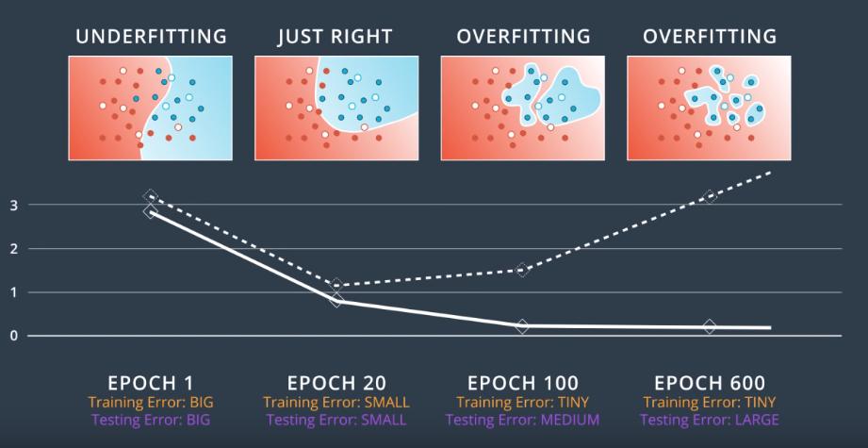

Slide 42
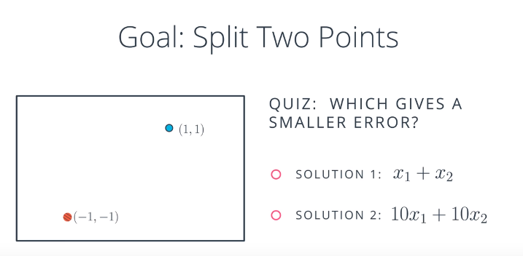

Slide 43
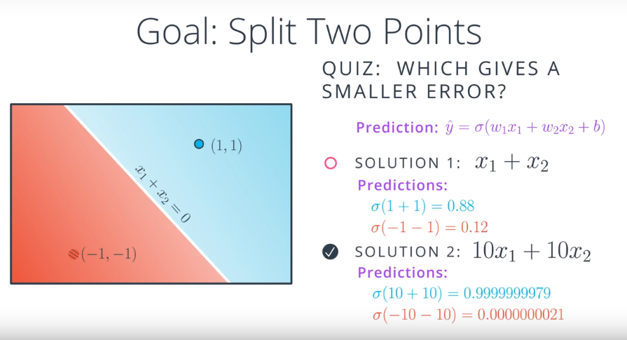

Slide 44
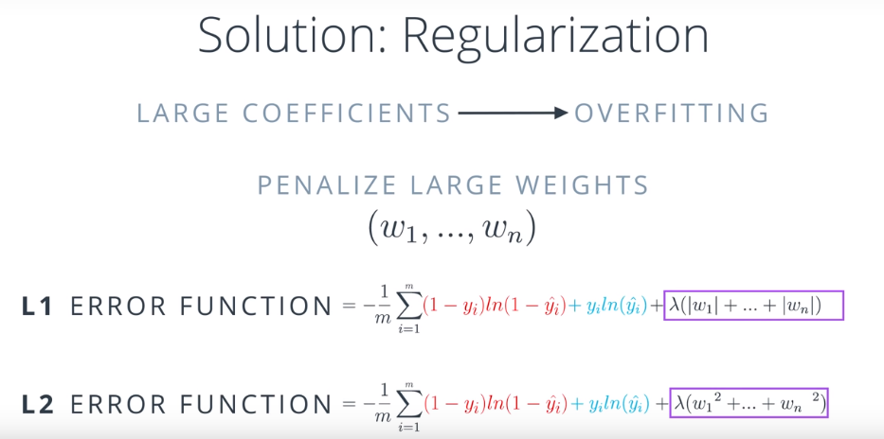

Slide 45


Slide 46
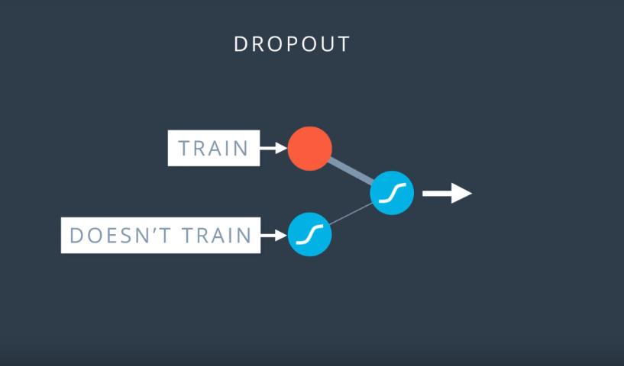

Slide 47
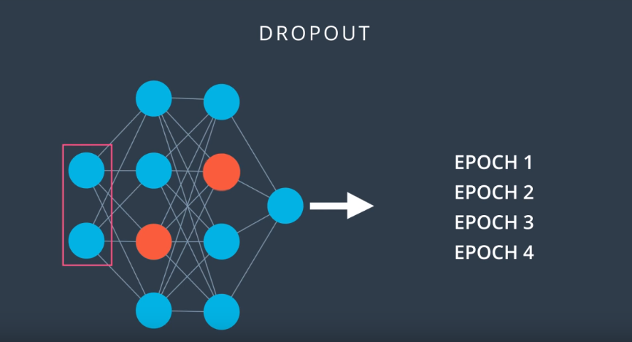

Slide 48
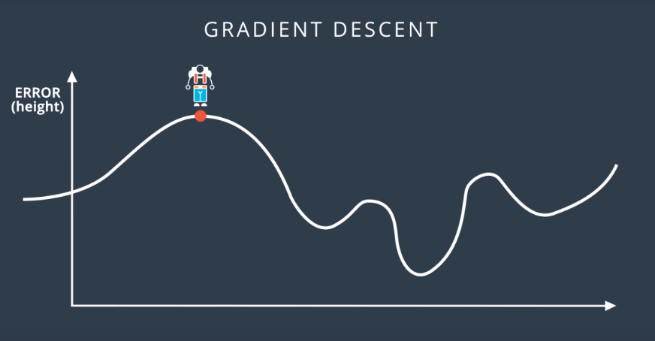

Slide 49
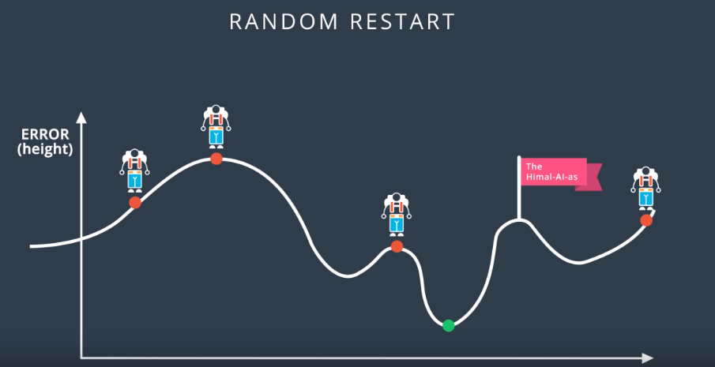

Slide 50
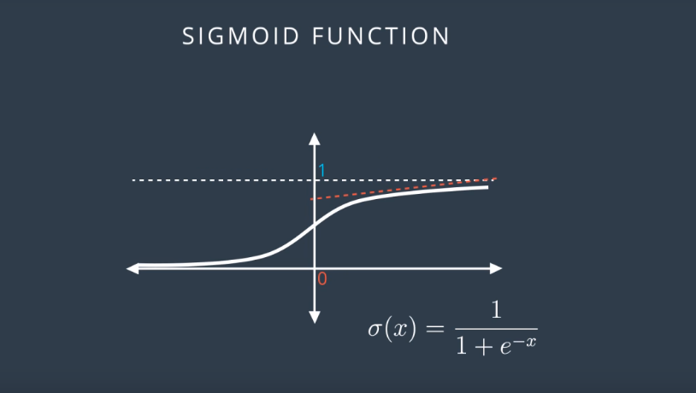
Vanishing Gradient

Slide 51
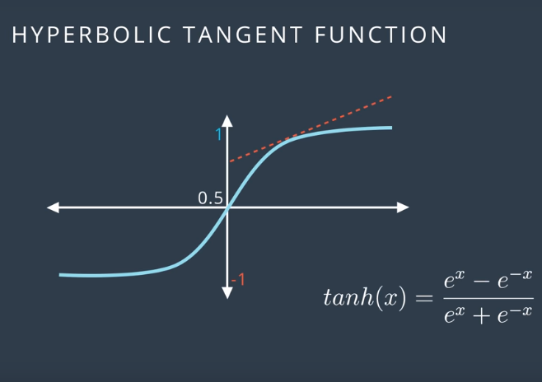
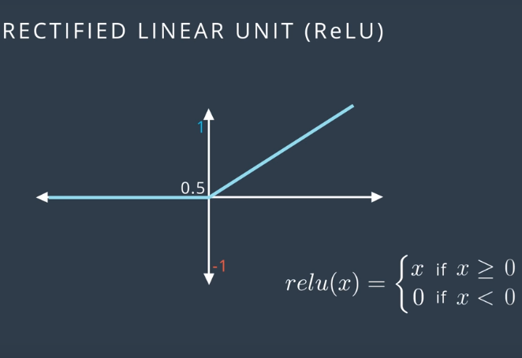
Solution :

Slide 52
Batch Gradient Descent
Batch Gradient Descent calculates the error for each example within the training dataset and after all training examples have been evaluated, the model gets updated. This whole process is like a cycle and called a training epoch.
Advantages
Computational efficient
It produces a stable error gradient
A stable convergence
Disadvantage
Requires a lot of training epochs
It also requires that the entire training dataset is in memory

Slide 53
Stochastic Gradient Descent
Stochastic gradient descent calculates error for each training example within the dataset. It updates the parameters for each training example, one by one.
Advantage
The frequent updates results in a detailed rate of improvement.
Requires less number of training epochs.
Disadvantages
Computationally expensive
The frequency of those updates can also result in noisy gradients, which may cause the error rate to jump around, instead of slowly decreasing.
It might not reach global minimum

Slide 54
Mini Batch Gradient Descent
It is a combination of Stochastic Gradient Descent and Batch Gradient Descent. It splits the training dataset into small batches and performs an update for each of these batches.
It creates a balance between the robustness of Stochastic Gradient Descent and the efficiency of Batch Gradient Descent.
Common mini-batch sizes range between 50 and 256.
It is the most common type of gradient descent algorithm.

